Slide 1

Introduction to Machine Learning
Paulin Rosset
Baccalaureate student

Slide 2
Index
What is Machine Learning?
Supervised Machine Learning basics
Presentation of the Random Forest algorithm
How should we use Machine Learning in research

Slide 3
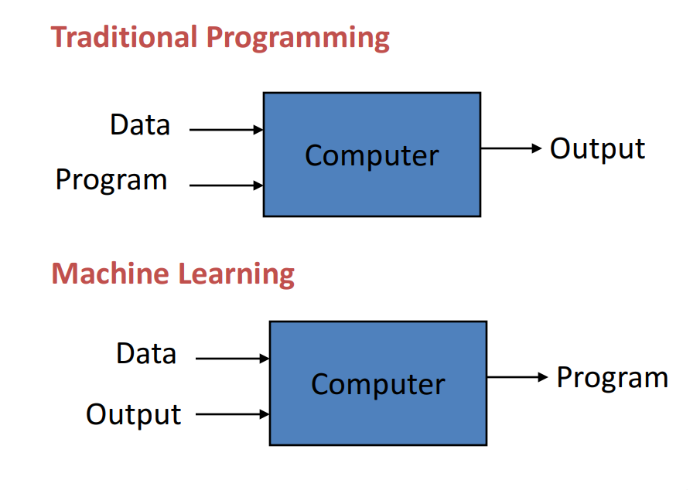
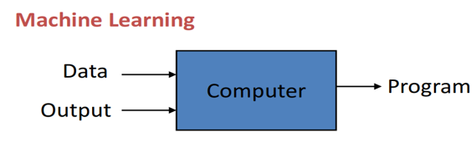
I) What is Machine Learning?

Slide 4
What is Machine Learning?
Definition: Design algorithms that learn how to make decisions based on empirical data

Slide 5
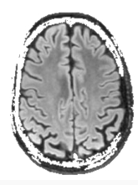
I) What is Machine Learning?
Does the patient suffer from Alzheimer?
?

Slide 6

I) What is Machine Learning?
Does the patient suffer from Alzheimer?
Training
Data =
Model
Known output = YES
Examples from the past!

Slide 7
I) What is Machine Learning?
Does the patient suffer from Alzheimer?
The goal of a ML model being to predict the right output given any external data.
Testing
New Data =
Model
Prediction
Is the prediction the same as the actual value of the output ?
Output: NO

Slide 8
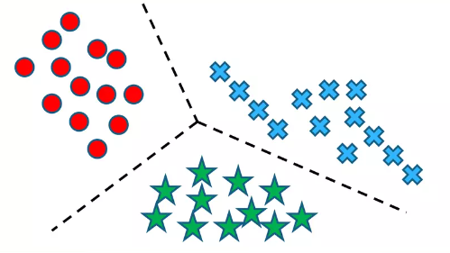
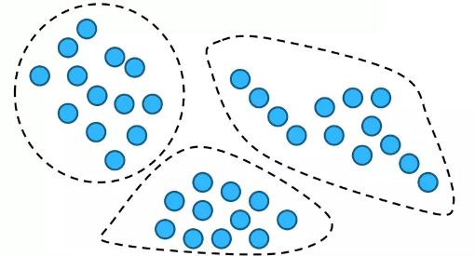
3 types of Machine Learning algorithms:
Supervised
Unsupervised
Reinforcement
Grouping into meaningful categories:
Use of labeled data (known outputs)
Clustering and finding anomalies:
Use of unlabeled data
Create an autonomous agent:
AlphaZero
DeepMind

Slide 9
3 types of Machine Learning algorithms:
Supervised
Unsupervised
Reinforcement
Grouping into meaningful categories:
Perceptron
SVM
Random Forests
Neural Networks
Clustering and finding anomalies:
PCoA
Create an autonomous agent:
AlphaZero
DeepMind

Slide 10

II) Supervised ML basics: Terminology
features
Feature vector (datapoint)
n-dimensional vector of numerical features
that represent some object.
X_{i} =
Labels (target values)
The characteristics on which the feature vectors of a dataset are categorized
Y_{i}
Model
Program that can find patterns or make decisions from a previously unseen dataset.
h(X_{i}) ~ Y_{i}

Slide 11
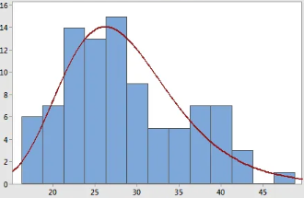
II) Supervised ML basics: Terminology
X_{i} | x₁ | x₂ | x₃ | x₄ | Y_{i}
1 | 4.3 | 4.9 | 4.1 | 4.7 | 0
2 | 3.9 | 6.1 | 5.9 | 5.5 | 0
3 | 2.7 | 4.8 | 4.1 | 5.0 | 1
4 | 6.6 | 4.4 | 4.5 | 3.9 | 1
Dataset: D = {(X₁,Y₁),.., (X_{i},Y_{i}),.., (X_{n},Y_{n})} ~ P
X₁ = , Y₁ = 0
Unknown distribution
D: P:
Frequency (%)
sample of P distribution
underlying distribution
For every external point drawn from P, the model tries to guess the label of it.
(X_{j},Y_{j}) ~ P, h(X_{j}) Y_{j}

Slide 12
Translation in new terms
Does the patient suffer from Alzheimer ?
Training
Data =
Model
Known output = YES

Slide 13
Translation in new terms
Does the patient suffer from Alzheimer ?
Training
X₁ X₂ X₃
Data =
h
Label: Y₁ Y₂ Y₃

Slide 14
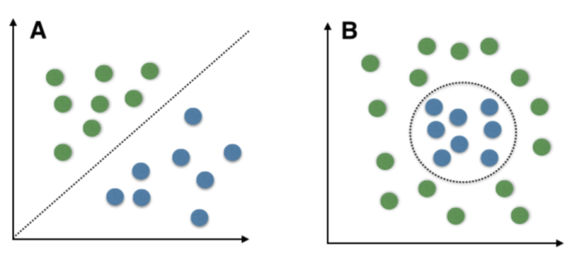
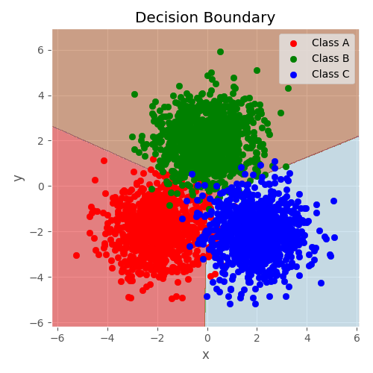
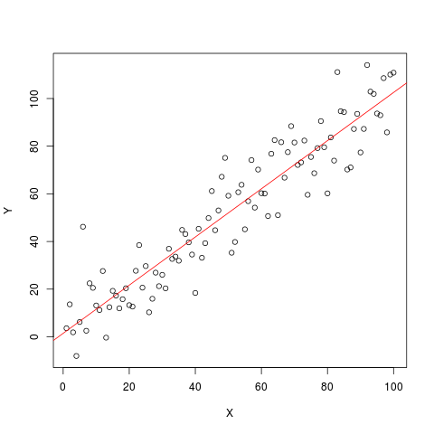
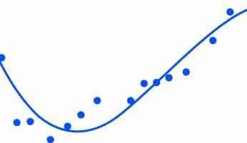
2 types of SML algorithms
+1
Classification: Y = {1,..,K} with K ∈ ℕ
Ex: Y = {spam, non-spam}, {sport, politics, art,..}
-1
- Predict a discrete class label
Binary classification
Multiclass classification
Regression: Y = ℝ
Ex: Y = [0$,1 million $], [100 cm, 250 cm]
- Predict a continuous target value
Polynomial regression
Linear regression

Slide 15
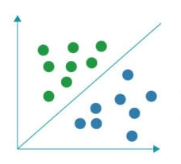

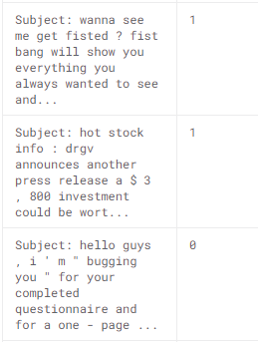
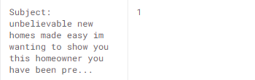
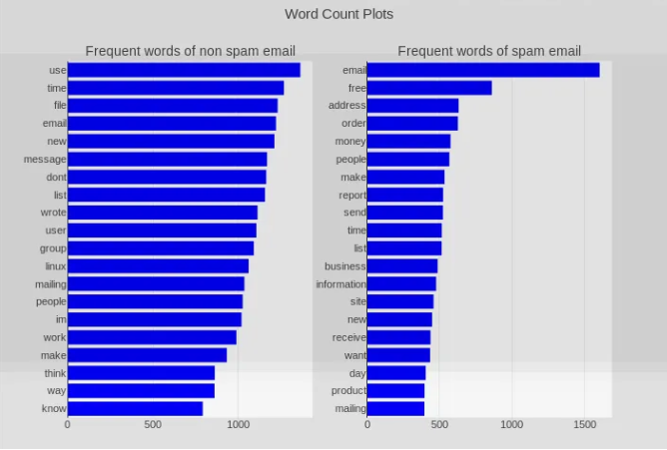
Useful cases of SML: Classification
Spam
Spam filter
Y_{i} ∈{spam, non-spam}
Non-spam
--> a
--> abandon
--> abashed
--> ..
--> ..
--> win
--> ..
Binary classification graph
X_{i} =
d = number of word in the English dictionnary
Word occurences from the i email
Spam filter dataset
Bar chart visualization of 1-gram model

Slide 16
SML algorithms
Classification: Y = {1,..,K} with K ∈ ℕ
Ex: Y = {spam, non-spam}, {sport, politics, art,..}
- Predict a discrete class label
Binary classification
Multiclass classification
Regression: Y = ℝ
Ex: Y = [0$,1 million $], [100 cm, 250 cm]
- Predict a continuous target value
Polynomial regression
Linear regression

Slide 17
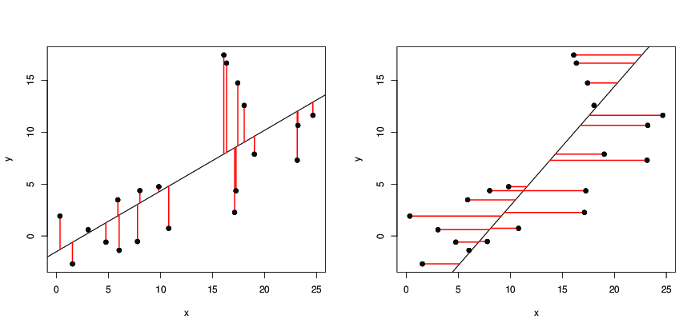
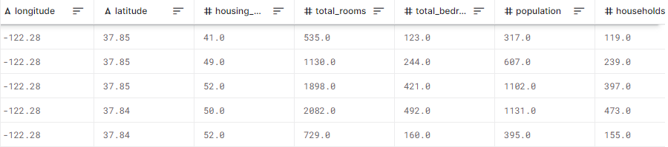
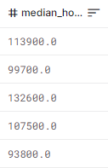
Useful cases of SML
Regression : Y = ℝ
House price prediction
Each (X_{i},Y_{i}) in D is a house from P that had been sold.
--> tranquility
--> surface area
--> bathrooms
--> garden
--> Transports access
..
X_{i} =
Price: Y_{i} ∈ [0,+∞[
Dataset:
Features X_{i}
Y = median house value

Slide 18
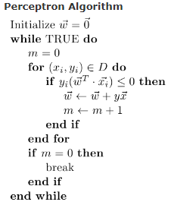
Training process: Perceptron
Démo:
https://mlweb.loria.fr/book/en/perceptron.html
Missclassified ?
Then updating
We learn the 2 parameters that define a straight line:
- w: direction vector (slope)
- b: ordinate at origin

Slide 19
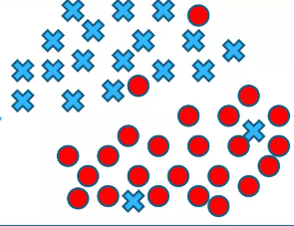
Splitting the dataset
1) Split in Training/Testing set
Initial dataset
Unobserved!
Training set
Dataset used to find the best model
Testing set
Dataset used to test the model found
Objective measure of how well the model does: test error rate
Looking at the test set is like looking at the answers before your exam. Not fair, not generalized
The test set must be used once in its lifetime!
Otherwise we are biased by knowing its structure

Slide 20
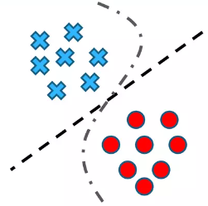
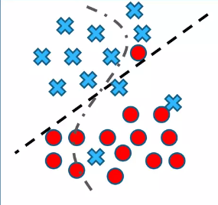

Training/Testing process: missing set?
1) Split in Training/Testing set
Initial dataset
Unobserved
2) Finding the best model (training)
3) Testing the best model
Training set
Testing set
Observed
Unobserved
OVERFITTING!
Error rate low
Error rate high

Slide 21
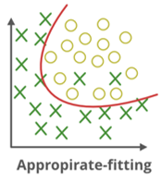
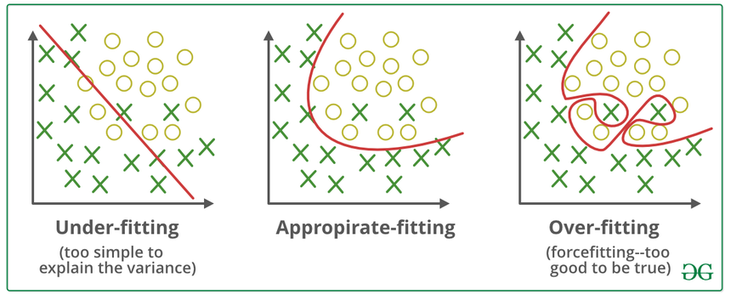
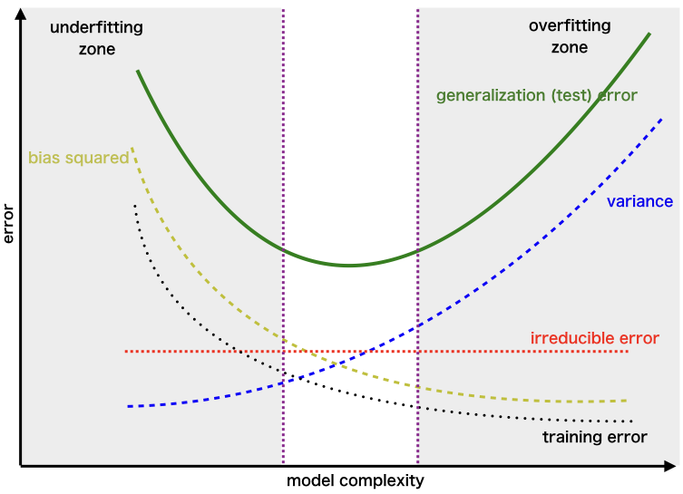
Overfitting
Definition: model learns the training data by heart, instead of learning the underlying patterns
Test error high
training error is close to 0
An overfitted model can’t perform well on unseen dataset.

Slide 22
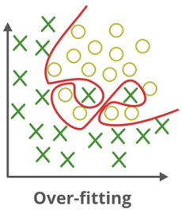
Training/Testing process: missing set!
1) Split in Training/Testing set
Initial dataset
Unobserved
2) Finding the best model (training)
3) Testing the best model
Training set
Testing set
Observed
Unobserved
We selected the model that best fitted the training set, not the best model overall.
Need to introduce a an intermediate set: validation set

Slide 23
Training/Testing process: missing set!
Training set
Validation set
Testing set
Validation set kills overfitted models to training set

Slide 24
Final Training/Testing process
Practical usage
Be careful on how you are splitting !
Data acquisition
Time
Training set
Validation set
Testing set
Model 1
Model 2
Run &
Pick the best
Run the previous best
Model 3
Model 4
………….
Model m
Differ by their hyper-paramets combination
Training error
Validation error
Test error (generalized)
Training error < Validation error < Test error always !

Slide 25
Dataset split: randomly!
Be careful on how you are splitting !
X_{i} | X₁ | x₂ | x₃ | x₄ | Y_{i}
1 | 4.3 | 4.9 | 4.1 | 4.7 | 0
2 | 3.9 | 6.1 | 5.9 | 5.5 | 0
3 | 5.8 | 2.4 | 3.1 | 4.0 | 0
4 | 2.7 | 4.8 | 4.1 | 5.0 | 0
5 | 6.6 | 4.4 | 4.5 | 3.9 | 0
.. | .. | .. | .. | .. | 0
.. | .. | .. | .. | .. | 1
.. | .. | .. | .. | .. | 1
?
Training set
Validation set
Testing set
Data randomly shuffled
…………………………………………………………

Slide 26

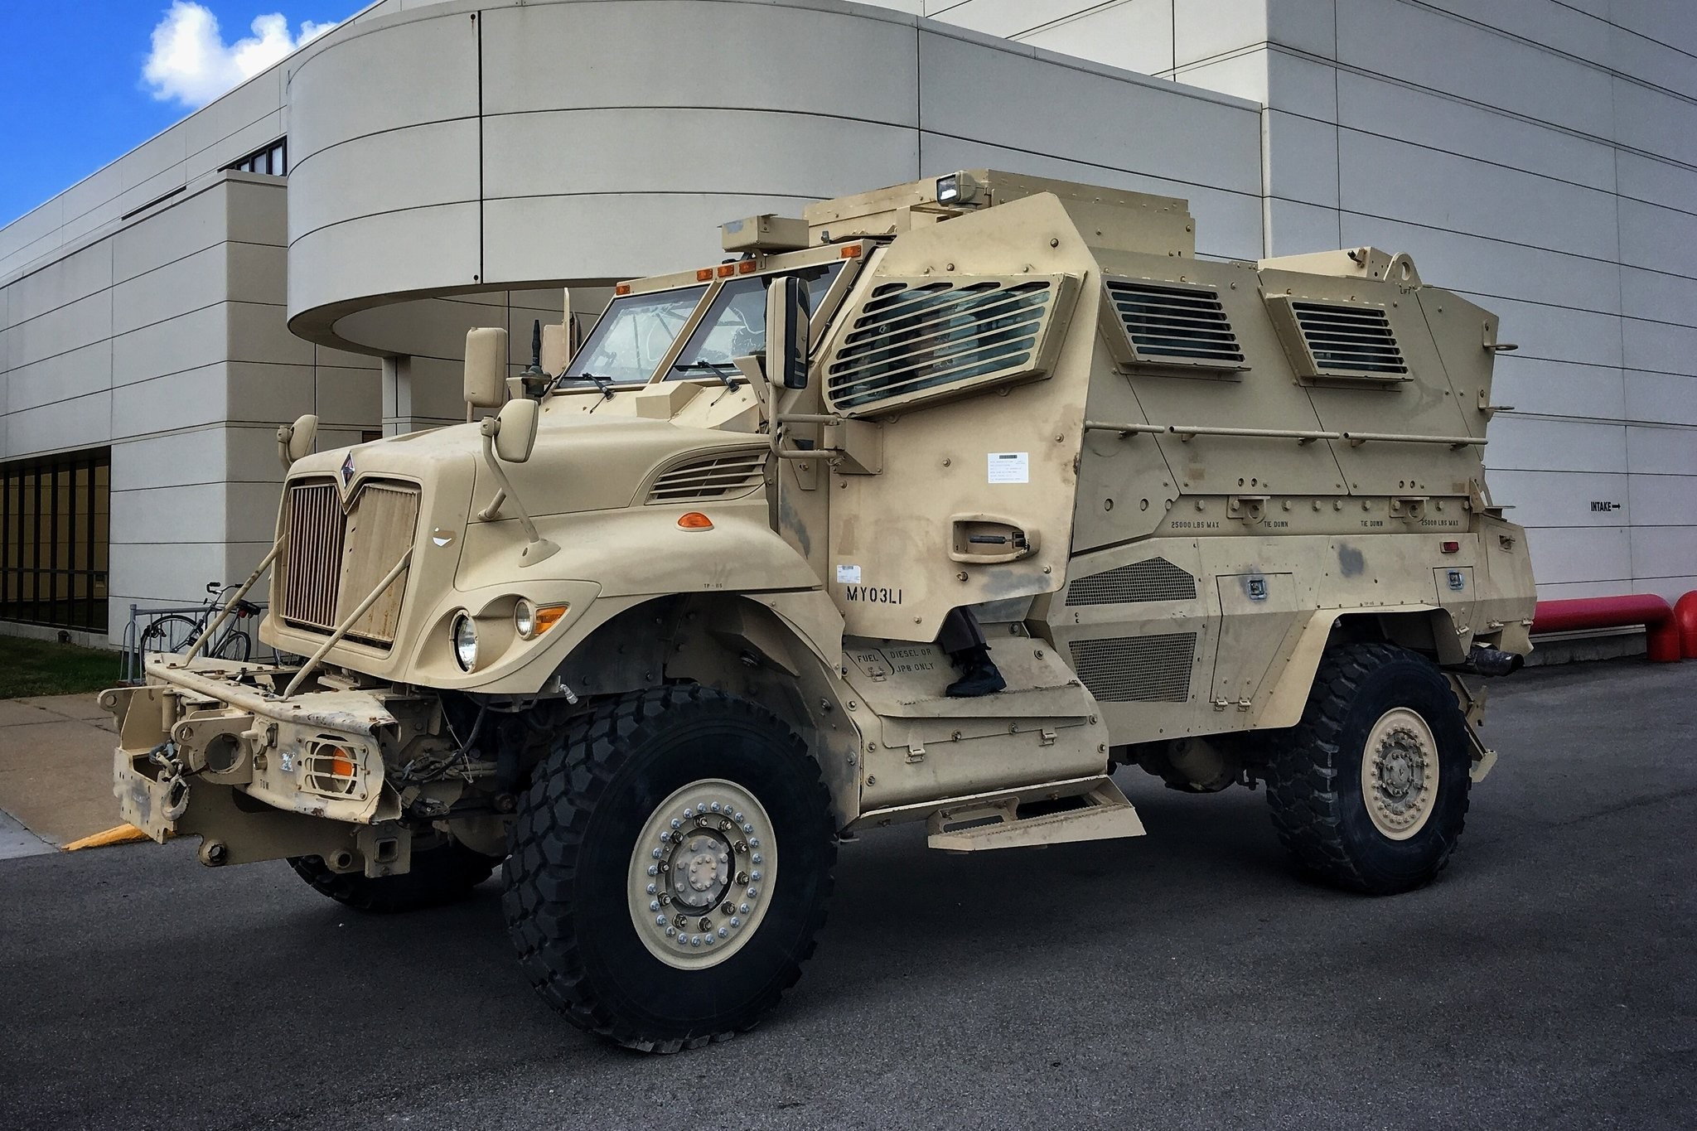
Importance of the distribution P
U.S. Army fail: vehicles classification
Y_{i} ∈ {military,civilian}

Slide 27
Importance of the distribution P
9 am
4 pm
Civilian
YES
Distribution P must represent real world systems.
High luminosity?
Vehicle Picture
Military
NO
Their distribution assumed that civilian vehicles only exist in the afternoon and vice-versa.

Slide 28
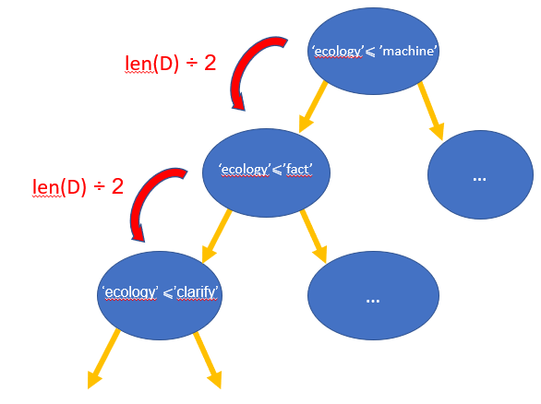
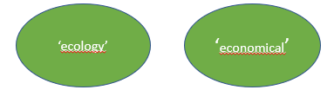
III) Intro to Random Forest
What is a binary tree?
Binary Search(‘ecology’,D)
Binary Decision tree
Let D a 30000 words dictionary (N=30000)
- D=list(‘a’,’abandon’,’abashed’,…)
- D[len(D)/2] = ‘machine’
x₁>4.3
yes
no
1
x₂<6.1
…
yes
no
0
1
leaf
decision node
In ~10 iterations ! (O(log(N))
root

Slide 29
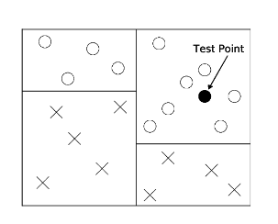
Binary decision tree
Dataset
X_{i} | x₁ | x₂ | x₃ | x₄ | Y_{i}
1 | 4.3 | 4.9 | 4.1 | 4.7 | 0
2 | 3.9 | 6.1 | 5.9 | 5.5 | 0
3 | 2.7 | 4.8 | 4.1 | 5.0 | 1
4 | 6.6 | 4.4 | 4.5 | 3.9 | 1
x₁>4.3
yes
no
1
x₂<6.1
Visualization
x₁>4.3
Y = { , }
yes
no
0
1
Pure leaf: subspace that contains points that belong to one label
Decision are weak learners (slightly better than random guessing)
leaf
decision node
=> Because of overfitting (arbitrary comparisons, feature order,..)
Split until each leave is pure
root node

Slide 30
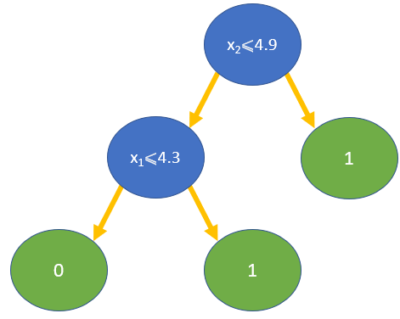
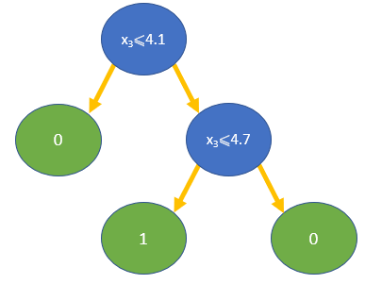
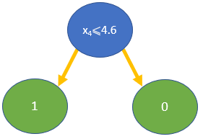
Random Forest
Overfitting !
D: training set
D = (X_{i},Y_{i})_{n} ~ P
Binary classifier: Y = {0,1}
Idea: we draw D₁,..,D_{m} from D with replacement. Each D_{j} learns a decision tree until its training error equals 0.
D:
X_{i} | x₁ | x₂ | x₃ | x₄ | Y_{i}
1 | 4.3 | 4.9 | 4.1 | 4.7 | 0
2 | 3.9 | 6.1 | 5.9 | 5.5 | 0
3 | 2.7 | 4.8 | 4.1 | 5.0 | 1
4 | 6.6 | 4.4 | 4.5 | 3.9 | 1
Bagging
X_{i}
3
1
3
4
X_{i}
1
2
4
1
X_{i}
3
2
4
2
bootstrapping
feature selection
x₁, x₂
x₂, x₃
x₃, x₄
5 | 2.8 | 6.2 | 4.3 | 5.3
Y₅ = 1
1
0
1

Slide 31
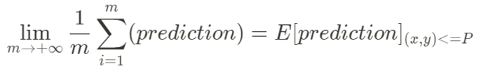
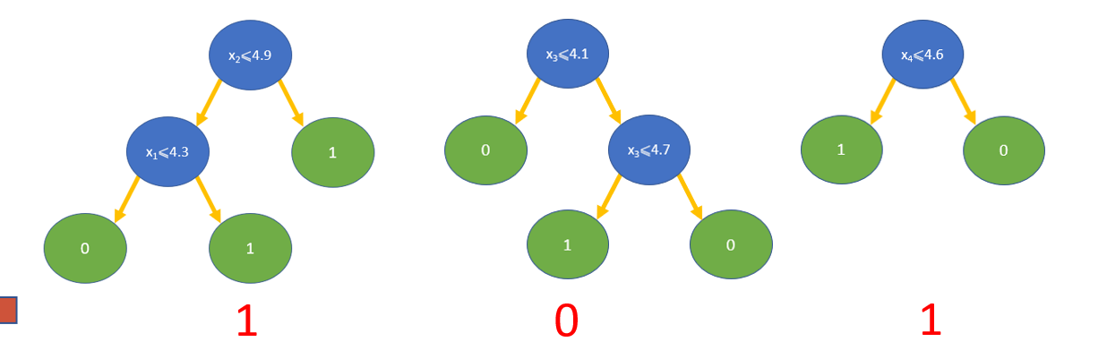
Random Forest: Why does it work?
=> Weak law of large numbers: average of random independant experiences becomes the expected value in the limit
Features: x₁,x₄ x₄,x₃ x₄,x₁ x₄,x₂
x₁,x₂ x₃,x₁ x₃,x₁ x₁,x₂ x₃,x₂
…
Predictive trees
Non-predictive trees
Ex: freq(Y = 1) = 3/4
freq(Y = 1) = 1/2
=> freq(Y = 1) > 1/2
=> Errors average out (0 and 1 compensate each other)
Predictive features gives the final prediction: 1

Slide 32
Strength of Random Forest
Doesn’t suffer from the curse of dimensionality
Easy to use
Highlight predictive features
Easily interpretable

Slide 33
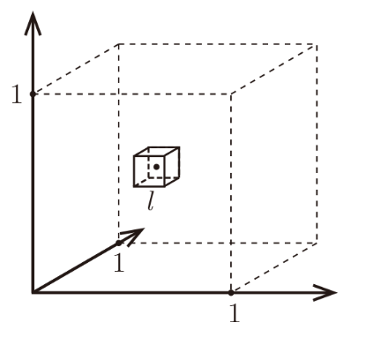
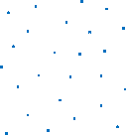
Unit hypercube
1)Curse of Dimensionality
ℓ hypercube
Imagine the unit hypercube [0,1]^{d} (we can’t visualize further d=3)
- All training data is sampled uniformly within this cube: ∀i⩽n, x_{i} ( ) ∈ [0,1]
- We build the hypercube of length ℓ as it contains the k=10 nearest neighbors of the test black point
Hypercube (d-dimensional object):
0
d=1
d=2
d=3

Slide 34
Unit hypercube
1) Curse of Dimensionality
Imagine the unit hypercube [0,1]^{d} (we can’t visualize further d=3)
- All training data is sampled uniformly within this cube: ∀i⩽n, x_{i} ( ) ∈ [0,1]
- We build the hypercube of length ℓ as it contains the k=10 nearest neighbors of the test black point
ℓ hypercube
d=1:
Uniform distribution
Interval scaled to 1
=> P( in ) = ℓ
0
ℓ
1
0
y
d=2:
1
d=2:
P( in 2* ) = ℓ²
= (x,y)
“In 3d, the probability that a given point is inside the l hypercube is ℓ³”
d=3:
P( in 3* )= ℓ³
ℓ
“In d-dimension, the probability that a given point is inside the l hypercube is (ℓ)^{d}”
x
0
1
ℓ

Slide 35
16/08/2023

Slide 36
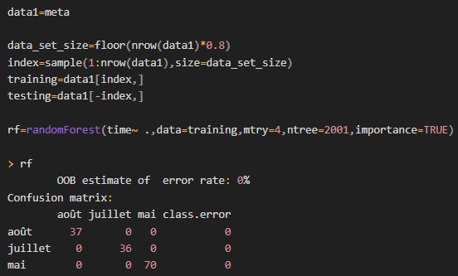
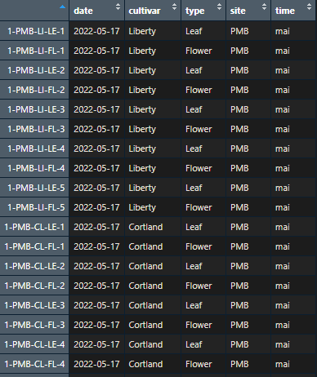
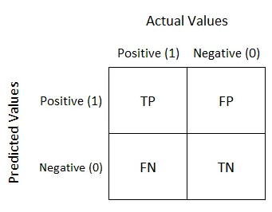
2) Easy to use: example on Sophie’s dataset
Multiclass classifier: time = {May, July, August}
2 parameters:
mtry: nb of selected features
ntree: nb of trees
mtry =
“lower superior integer of d”
Training error
What is a confusion matrix?
Accuracy =

Slide 37

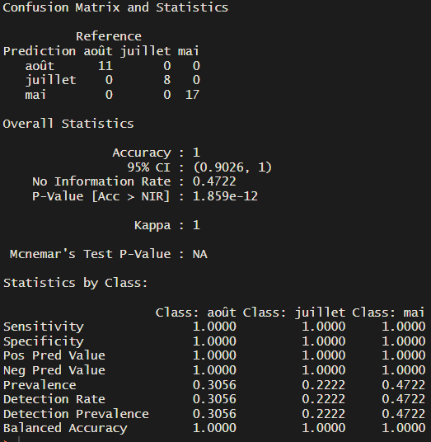
2) Easy to use: Test results
Dataset with the date feature
Generalized error
0% !

Slide 38
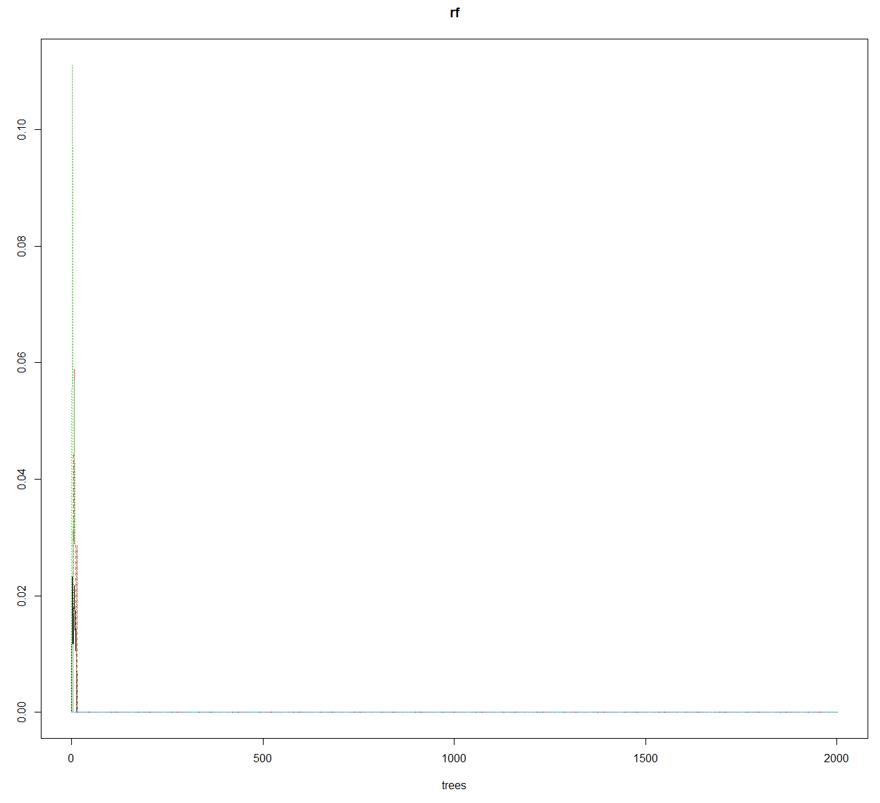

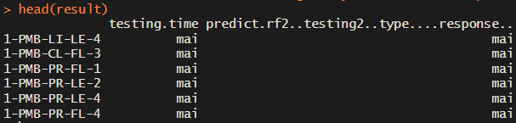
2) Easy to use: Test results
head(result)
Plot(rf)

Slide 39
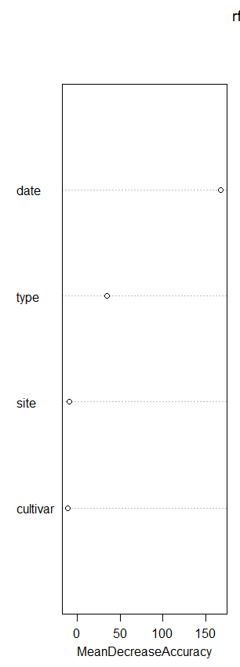
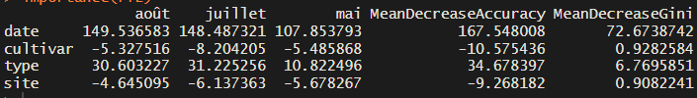
3) Highlight the predictive features
Predictive power
Mean Decrease Accuracy: Measure of the accuracy of a random forest model by excluding each variable.
varImpPlot(rf)
=> Removing the date feature would make the model missclassify around 167 additional observations

Slide 40
4) Easily interpretable
Colorectal cancer prediction:
Given a sample of patient’s stomach microbiome, we want to predict either if the patient has colorectal cancer or not.
Binary classifier:
Y = {Cancer sufferer,Healthy}

Slide 41
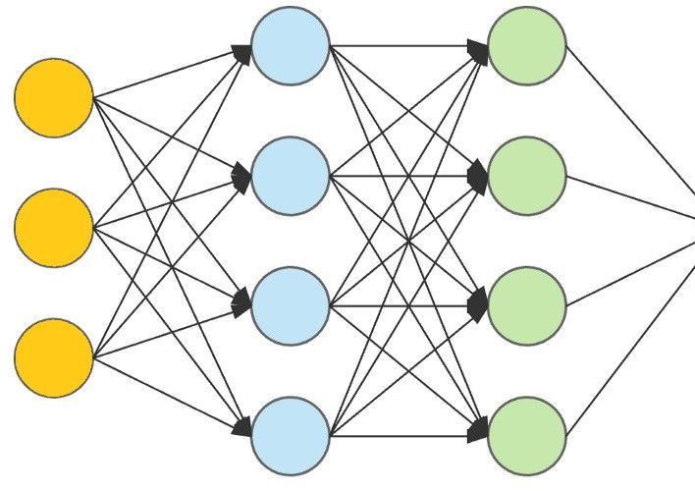
4) Easily interpretable
Colorectal cancer prediction:
Y = {Cancer sufferer,Healthy}
Neural Networks
INPUT
OUTPUT
Cancer sufferer
sample
From the microbiome of patient

Slide 42
4) Easily interpretable
Colorectal cancer prediction:
Y = {Cancer sufferer,Healthy}
Neural Networks
INPUT
Not interpretable
OUTPUT
Cancer sufferer
sample
From the microbiome of patient
You might have a wonderful predictive model, but you have no explanatory power

Slide 43
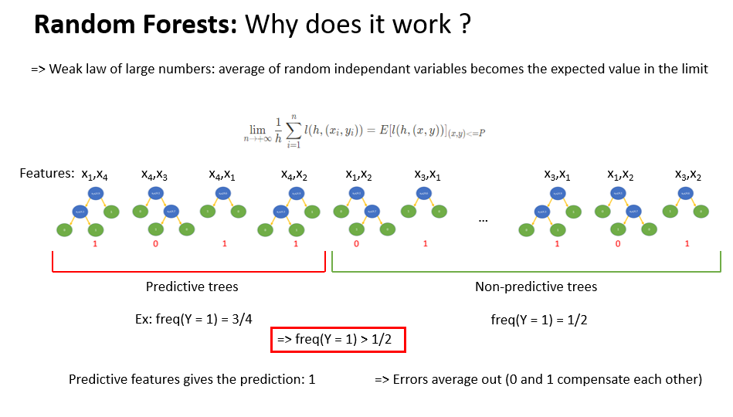
4) Easily interpretable
We know perfectly how the RF algorithm is working
We have further interpretation with its ability to spot predictive features.

Slide 44
IV) What can we deduce from ML? : Colorectal cancer
Let’s get the stomach bacterias characteristics of a colorectal cancer.
TAXONOMY
Caracteristic of a healthy patient ? Suffering patient?
+
Training/Testing process
Dataset
Sample 1
Sample 2
Sample 3
Sample 4
ASV table
ASV56
ASV789
ASV5765
Amnibactérium
Novosphingobium
Deinococcaceae
RF Model
ML is just about predictions, seeking for underlying correlations
NO!
- Can we say these bacterias are the “cause” of the cancer?
- If we prove in an other way that a specific bacteria is always found in cancer sufferers, can we conclude it is a cause?

Slide 45
ML doesn’t make classical statistics useless
Confounding:
Causal inference
↗ murder rate
Unknown confounder
↗ heat
(confounder)
Causality link
↗ ice cream consumption
Unknown causality link
=> Ice cream consumption is a nice predictive feature to murder rate.

Slide 46
What can we deduce from ML? : Colorectal cancer
TAXONOMY
+
Training/Testing process
Dataset
Sample 1
Sample 2
Sample 3
Sample 4
ASV table
ASV56
ASV789
ASV5765
Amnibactérium
Novosphingobium
Deinococcaceae
RF Model
We can deduce that these bacterias have a strong predictive power in recognizing cancer sufferers given their microbiome
Can’t publish results on how much these bacterias are involved in cancer infection, but the information that these bacterias play a role could be precious for further studies

Slide 47
END OF PRESENTATION

Slide 48
x₃⩽4.1
x₄⩽4.6
0
x₃⩽4.7
1
0
1
0
len(D) ÷ 2
‘ecology’⩽ ’machine’
…
len(D) ÷ 2
‘ecology’⩽’fact’
…
‘ecology’ ⩽’clarify’

Slide 49
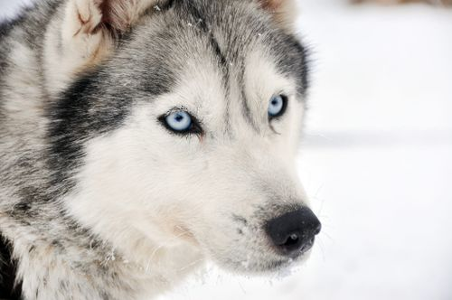
4) Easily interpretable
Neural Networks: image recognition
DOG

Slide 50
What is Machine Learning ?
Training
Testing
X = {X₁,..,X_{i},..,X_{n}}: set of the points
Y = {Y₁,..,Y_{i},..,Y_{n}}: set of the labels
Expected classifier:(X_{i}) = Y_{i}

Slide 51
Classical Statistics VS ML
A principal distinction between statistical models and ML is that the goal of the former is to describe and infer the relationships between variables, whereas the latter is designed to optimize the ability to predict an outcome on an external dataset
Not indep since not the same amount of strands within a sample
Not identically distributed (some are abundant on one leaf, inexistant on others) depends on which leaves we take (bias)
Co-abundance: relative abundance
In sequencing, we copy by a fixed number each strand, no matter what its size is.
Green: 50% vs 33%
But what about the real abundance? Quantity of DNA ? We can’t know
ML is highly configurable
ML is great at identifying subtle variation in microbial community structure and can identify specific bacterial taxa that underlie prediction of a conditional outcome.
ML needs less assumption

Slide 52
1
ℓ
0
ℓ
1

Slide 53
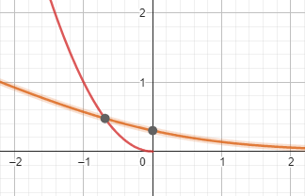


Model fitting
Bias
Variance
Ajouter cette slide nous oblige de parler de bias/variance de rf
Underfitting: model does wrong assumptions
Optimized by regularization: we choose the complexity of the model

Slide 54
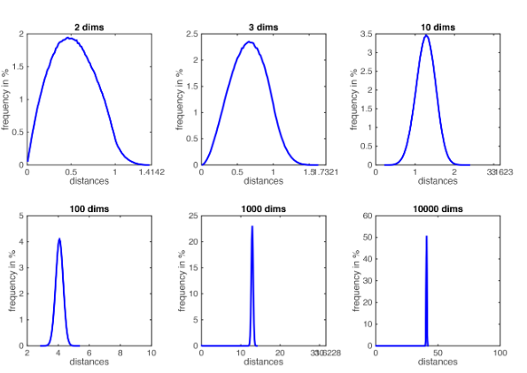

Curse of Dimensionality
Imagine the unit hypercube [0,1]^{d} (we can’t visualize further d=3)
- All training data is sampled uniformly within this cube: ∀i⩽n, x_{i} ( ) ∈ [0,1]
- We build the hypercube of length ℓ as it contains the k=10 nearest neighbors of the test black point
d=1 & n=20: (hypercube is an interval)
Scaled to 1 !
0
ℓ
1
ℓ¹≈ = 0.5 => seems accurate !
Then ℓ ^{d}≈ => ℓ ≈
= Proportion !!
Here we take n=1000 and k=10:
We are choosing the 10 nearest points out of 1000. In 2D, we have to build a hypercube that is 10% of the bigger cube.
If d=10, the hypercube has to be 63% of the unit cube ! Every point is far away !
What’s the solution ? => Don’t compute any distance
As the dimension increases, all distances concentrate within a very small range => concept of neighbor vanishes
At d=10000: Points are equidistants

Slide 55
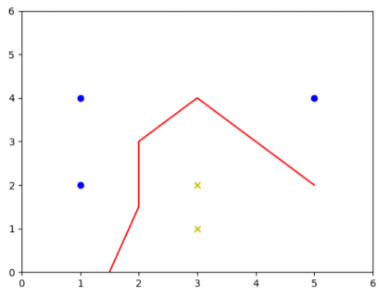
Visualization
Y_{i} = -1
Binary classifier: Y = {-1,+1}
Y_{i} = -1:
X₁ = (1,2)
X₂ = (1,4)
X₃ = (5,4)
Y_{i} = +1:
X₄ = (3,2)
X₅ = (3,1)
Y_{i} = +1
model
1-NN decision boundary

Slide 56



2) Easy to use: Test results
Dataset without the date feature

